Slide 1
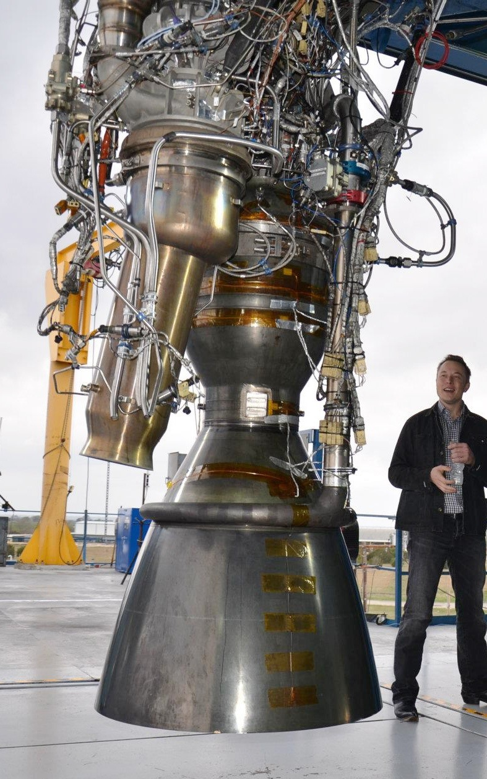
Liquid Rocket Engines
Require many moving parts and plumbing.
Require cryogenic or toxic fuels. Cryogenic fuels must be kept cold.
Oxidizer and fuel must be kept in separate tanks. Cannot be stored in rocket for long periods of time.
Often require pressurants and/or turbopumps to ensure that fuel and oxidizer flow into the combustion chamber.
Although some ballistic missiles use liquid rocket engines, tactical missiles rarely use them.
http://thisworldandothers.files.wordpress.com/2013/04/20130423-232832.jpg

Slide 2
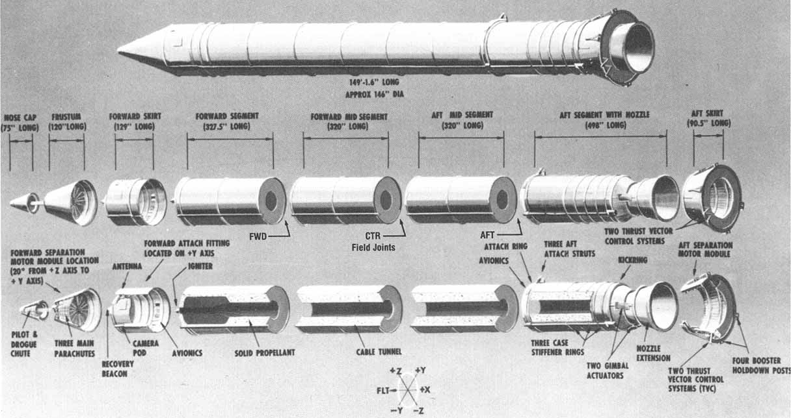
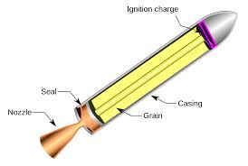
Solid Rocket Engines
Few (if any) moving parts.
Solid Propellant storable at room temperature for years.
Simple design and fabrication.
Lower Isp than liquid engines. Cannot stop or throttle after ignition.
A better choice than liquids for most missiles.
https://www.awesomestories.com/asset/view/Space-Shuttle-Solid-Rocket-Booster-in-Segments
http://upload.wikimedia.org/wikipedia/commons/thumb/7/70/SolidRocketMotor.svg/2000px-SolidRocketMotor.svg.png

Slide 3
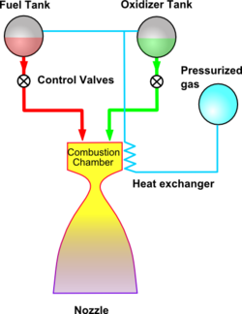
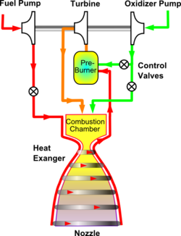
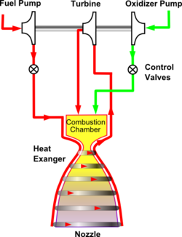
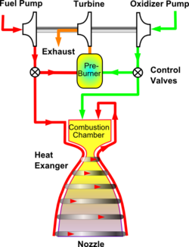
Liquid Rocket Engine Cycles
Pressure-fed Cycle
Staged Combustion
Cycle
Expander Cycle
Gas-Generator Cycle
Images from http://en.wikipedia.org

