Slide 1
Introduction
Dr. Alfred Lynam
Email: Alfred.Lynam@mail.wvu.edu
Office: ESB 931
Website: http://multipleflybycapture.wvu.edu/
Assistant Professor,
Mechanical and Aerospace Engineering,
West Virginia University

Slide 2
Rockets Vs. Missiles
In generic terms, a “Rocket” is any vehicle that carries its own propellant (i.e. does not use oxygen from the atmosphere.)
In military terms,
A “rocket” is a powered, unguided munition.
A “missile” (or guided missile) is a powered, guided munition.
A “bomb” is an unpowered munition not fired from a gun. Unpowered, guided munitions are called “guided bombs” or “smart bombs”
A “projectile” is a munition fired from a gun.
A “torpedo” is a powered munition that travels through water.
A missile is typically powered by a solid rocket motor, although some missiles use liquid rocket engines or air-breathing propulsion.

Slide 3
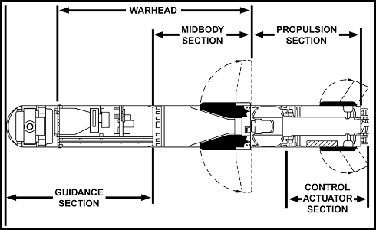
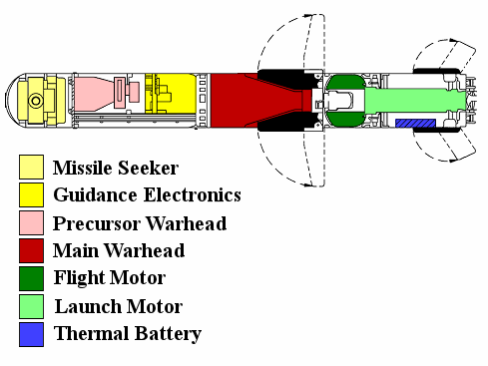
Missile Components
Guided missiles have a number of system components.
Targeting/Guidance System: Uses sensors and computers to determine the proper trajectory to follow to hit the target
Flight system: Steers the missile using inputs from the Targeting/Guidance system.
Engine: Provides thrust for the missile, allowing it to quickly reach its target.
Warhead: Destroys target upon impact.
http://www.alternatewars.com/BBOW/Weapons/US_ATGMs.htm

Slide 4
Types of Missiles
Surface-to-Surface Missile: Launched from the ground to hit a target on the ground.
Ballistic Missiles: Following boosting-phase, missile follows a ballistic trajectory.
Cruise Missiles: Typically fly at a low altitude and often use wings or turbojets to add lift and range.
Anti-Ship Missiles: Target enemy surface warships. To be effective, they must be able to get past enemy combat air patrol (CAP) and ship-based detection and interception.
Anti-Tank Missiles: Target enemy tanks and other armored vehicles or installations. Typically, use high-explosive, anti-tank (HEAT) warheads or kinetic energy penetrators.
Air-to-Surface Missile: Launched from an aircraft to hit a target on the ground. Cruise missiles, Anti-ship missiles, and Anti-tank missiles can also be launched from the air.

Slide 5
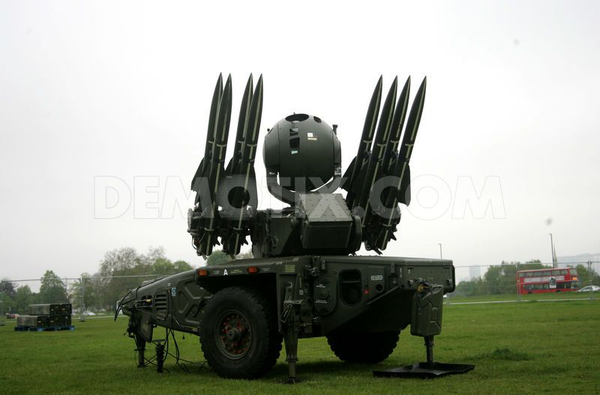
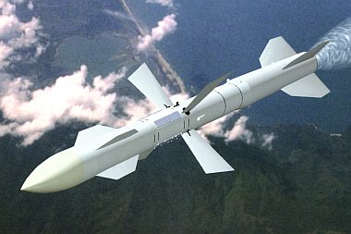
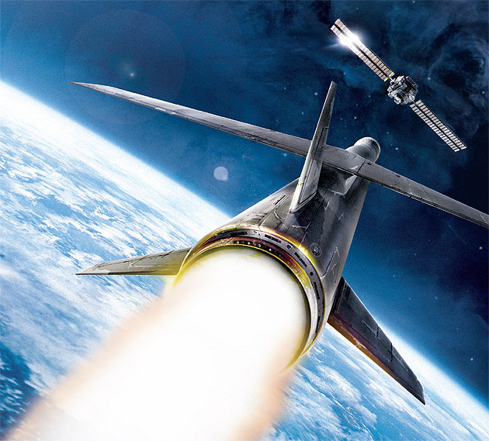
Types of Missiles (cont.)
Surface-to-Air Missiles: Launched from the surface to destroy enemy aircraft or missiles.
Air-to-Air Missiles: Typically launched from fighter or interceptor aircraft, they target enemy aircraft or missiles.
Anti-Satellite Missiles: Target satellites in Low-earth orbit. Require multiple-stage rockets to be effective.
http://static1.demotix.com/sites/default/files/imagecache/a_scale_large/1100-9/photos/1336073009-surface-to-air-missiles-deployed-at-blackheath--london_1191829.jpg
http://www.enemyforces.net/missiles/r_27.jpg
http://www.popularmechanics.com/cm/popularmechanics/images/Rn/china-cover-630-0707-de.jpg

